Slide 1
Successful Management
Through
Effective Leadership
Notes:
Set as a place marker.

Slide 2
Successful Management
Through
Effective Leadership
Notes:
Set as a place marker.

Slide 3
Overview
Leadership and management are not the same thing, but they are linked and complementary. Leadership is comprised of a series of qualities that have a direct impact on the management of your operations.
Leader
Manager
Notes:
TELL: Leadership and management are not the same thing, but they are linked and complementary. Leadership is comprised of a series of qualities that have a direct impact on the management of your operations.

Slide 4
Objectives
To strengthen current leadership and management skills with new fresh concepts.
This training will explore the key areas below:
Redefining leadership
Emphasizing leadership qualities
Practicing positive leadership
Creating SMART goals
Notes:
TELL: Our objectives for this training is to strengthen current leadership and management skills with new fresh concepts. This training will explore the key areas below: redefining leadership, emphasizing leadership qualities, practicing positive leadership, and creating SMART goals.

Slide 5
Self-Reflection
How many of you are completely comfortable calling yourself a leader?
Notes:
TELL: Let’s start with this question. How many of you are completely comfortable calling yourself a leader? You all lead a team in your cafeterias, right? Then everyone here should have their hands raised, but for some reason, there is a good portion of you that didn’t. And that’s probably because we have turned leadership into something bigger than us.

Slide 6
Leadership is Within
Leadership is not bigger than us, and certainly not beyond us. We have taken the title “leader” and treated it as if it’s something that we don’t deserve.
Many people think that being a leader is about:
Titles or positions
Controlling people
Changing the world
What is leadership about?
Notes:
TELL: Leadership is not bigger than us, and certainly not beyond us. We have taken this title “leader” and treat it as if it’s something that we don’t deserve. Being a leader is not about: Titles or positions, controlling people, or changing the world. So what is leadership about?

Slide 7
Redefining Leadership
Being a good role model
Communicating effectively
Getting to know staff
Setting and meeting goals
Setting a positive environment
Leadership is the ability to impact others through our actions.
Being a leader is about:
Notes:
TELL: Leadership is the ability to impact others through our actions. Being a leader is about: setting a positive environment, being a good role model, communicating effectively, getting to know your staff, and setting and meeting goals.

Slide 8
Creating a Positive Environment
Your operation benefits in countless ways when you cultivate a positive and productive workplace culture.
Be a leader who strives to bring positivity and energy to the cafeteria every day.
By setting a positive tone:
Your energy will be amplified by your staff
Happy employees are more likely to come to work everyday and are better workers
Turn problems into opportunities
Notes:
TELL: Your operation benefits in countless ways when you cultivate a positive and productive workplace culture. Be a leader who strives to bring positivity and energy to the cafeteria every day. By setting a positive tone: Your energy will be amplified by your staff. Have you heard that smiles are contagious, unfortunately so are frowns, so choose wisely! Happy employees are more likely to come to work everyday and are better workers. Turn problems into opportunities.

Slide 9
Being a Good Role Model
Actions speak louder than words. A role model is someone whose behavior, example, or success is emulated by others.
Power and authority come with your position
Being an example is the best way to change behavior without ruining relationships
Good behavior earns the respect of your staff
Example: Instead of telling them to work faster, show them how to prepare burgers with two hands to maximize efficiency.
Notes:
TELL: Actions speak louder than words. A role model is someone whose behavior, example, or success is emulated by others. Power and authority come with your position. Being an example is the best way to change behavior without ruining relationships. Good behavior earns the respect of your staff. Example: Instead of telling them to work faster, show them how to prepare burgers with two hands to maximize efficiency.

Slide 10
Communicating Effectively
Good leaders are also effective communicators. How can you inspire or guide others if you can’t communicate clearly?
Below are some applicable communication tips:
Be crisp, clear, and concise
Find your authentic voice (genuine)
Listen with your ears, eyes, and heart
Pay attention to your body language
Customize your communication style
Make sure that your actions align with your words
Notes:
TELL: Good leaders are also effective communicators. How can you inspire or guide others if you can’t communicate clearly? Below are some applicable communication tips: be crisp, clear, and concise, find your authentic voice (genuine), listen with your ears, eyes, and heart, pay attention to your body language, customize your communication style, make sure that your actions align with your words.

Slide 11
Checkers
Average managers play checkers, while great managers play chess.
In checkers, all the pieces are uniform and move in the same way. The pieces are interchangeable.
Notes:
TELL: Average managers play checkers, while great managers play chess.
SOLICIT AUDIENCE FEEDBACK: Anyone here play checkers?
In checkers, all the pieces are uniform and move in the same way. The pieces are interchangeable.

Slide 12
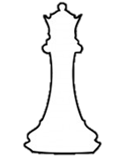
Chess
In chess, each type of piece moves in a unique way. In order to win, a strategy must be in place. It is impossible to be successful if you don’t know how to play each piece.
Notes:
TELL: However, in chess, each type of piece moves in a unique way.
SOLICIT AUDIENCE FEEDBACK: How many of you play chess?
In order to win, a strategy must be in place. It is impossible to be successful if you don’t know how to play each piece.

Slide 13
Being a Chess-Type Leader
Taking the time to understand your staff can help you position them in roles where they can thrive. The key areas below will guide you in understanding each member of your staff beyond the surface.
Strengths & Weaknesses
Personality
Motivational Triggers
Learning Styles
Notes:
TELL: Taking the time to understand your staff can help you position them in roles where they can thrive. The key areas below will guide you in understanding each member of your staff beyond the surface. Personality, strengths and weaknesses, motivational triggers, and learning styles.

Slide 14
Personality
Personality is a set of characteristics that distinguishes a person from others. It’s what makes you, YOU!
Your staff consists of different personality types. Understanding your staff’s diverse personalities will help you manage them better.
Notes:
TELL: Personality is a set of characteristics that distinguishes a person from others. It’s what makes you, YOU! Your staff consists of different personality types. Understanding your staff’s diverse personalities will help you manage them better.

Slide 15
Strengths and Weaknesses
Everyone has their set of talents and shortcomings. As the leader of your operation, identify the strengths and weaknesses of your staff to unlock their full potential.
Notes:
TELL: Everyone has their set of talents and shortcomings. As the leader of your operation, identify the strengths and weaknesses of your staff to unlock their full potential.

Slide 16
Strengths and Weaknesses
Everyone has their set of talents and shortcomings. As the leader of your operation, identify the strengths and weaknesses of your staff to unlock their full potential.
Capitalize on their strengths by assigning tasks that they flourish in
Evaluate their weaknesses and develop measurable goals for improvement
STRENGTHS
WEAKNESSES
STRENGTH METER
Notes:
TELL: Capitalize on their strengths by assigning tasks that they flourish in. Evaluate their weaknesses and develop measurable goals for improvement.

Slide 17
Reflection Activity 2
Part of being a strong leader is taking the time to appreciate your staff. Now, think of a weak leader…
On a scale of 1 to 10, how would you rate their skills on:
Recognizing
Praising
5
Most people would probably rate them at a low 2 or 3.
1
10
Now, rate yourself from 1 to 10.
Ask yourself:
How well do you recognize and praise your staff?
Notes:
TELL: Part of being a strong leader is taking the time to appreciate your staff. Now, think of a weak leader… On a scale of 1 to 10, how would you rate their skills on: Recognizing and Praising. Most people would probably rate them at a low 2 or 3. Now, rate yourself from 1 to 10. Ask yourself: How well do you recognize and praise your staff?

Slide 18
Too many work environments are focused on catching people making mistakes…
According to a poll by Gallup, 65% of Americans received no recognition in the workplace.
65%
Instead of catching your staff doing something wrong…
Notes:
TELL: So why is recognizing and praising important? Too many work environments are focused on catching people making mistakes… According to a poll by Gallup, 65% of Americans received no recognition in the workplace. Instead of catching your staff doing something wrong…

Slide 19
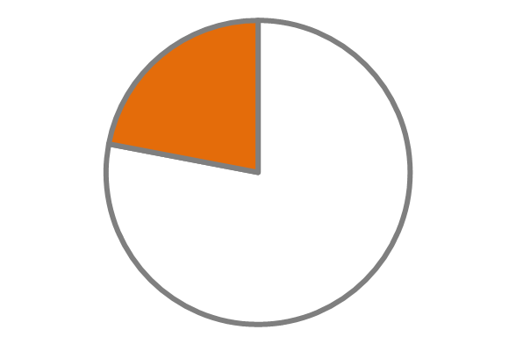
Catch your staff, doing something RIGHT!
78% of people would work harder if they were recognized.
-Globoforce
78%
Employees who receive praise are more productive, engaged with their customers, stay at their jobs longer, and even have fewer accidents on the job.
Notes:
TELL: Catch your staff, doing something RIGHT! 78% of people would work harder if they were recognized. Employees who receive praise are more productive, engaged with their customers, stay at their jobs longer, and even have fewer accidents on the job.

Slide 20
Motivational Triggers
Motivational triggers are factors that influence someone to do what they do each day.
Discover what motivates your staff members:
Public recognition
Verbal praise
Meeting with the manager
Token of appreciation
Sense of purpose
Everybody has a motivational trigger that gets them excited and ready to give themselves to a cause.
Notes:
TELL: Motivational triggers are factors that influence someone to do what they do each day. Discover what motivates your staff members: public recognition, verbal praise, meeting with the manager, token of appreciation, sense of purpose. Everybody has a motivational trigger that gets them excited and ready to give themselves to a cause.

Slide 21
How to Effectively Praise Staff
Do it Immediately
Be Specific
Be Genuine
Encourage Continuously
Give Kudos
The more time that passes between great
performance and recognition, the lower the impact.
Don’t just tell an employee she did a good job, tell
her how she did a good job. This will inspire her to
work harder.
Be genuine and let your employees know how you
really feel.
Don’t wait until the job is over, provide continuous
encouragement to your staff.
Recognize your top performers in a staff meeting.
The employee will feel good and encourage others
to do the same.
Notes:
TELL: Do it Immediately. The more time that passes between great performance and recognition, the lower the impact. Be Specific. Don’t just tell an employee she did a good job, tell her how she did a good job. This will inspire her to work harder. Be Genuine. Be genuine and let your employees know how you really feel. Encourage Continuously. Don’t wait until the job is over, provide continuous encouragement to your staff. Give Kudos. Recognize your top performers in a staff meeting. The employee will feel good and encourage others to do the same.

Slide 22
Learning Style
One size doesn’t fit all; people learn in a variety of ways. An effective leader analyzes and discovers the learning styles that would best benefit their staff.
These learning styles include:
Reading and writing
Learning through words
Visual
Images and graphics
Auditory
Listening and speaking
Kinesthetic
Hands-on learners
Visual
Auditory
Reading & Writing
Kinesthetic
Notes:
TELL: One size doesn’t fit all; people learn in a variety of ways. An effective leader analyzes and discovers the learning styles that would best benefit their staff. These learning styles include: Reading and writing-Learning through words. Visual-Images and graphics. Auditory-Listening and speaking. Most people are kinesthetic-Hands-on learners.

Slide 23
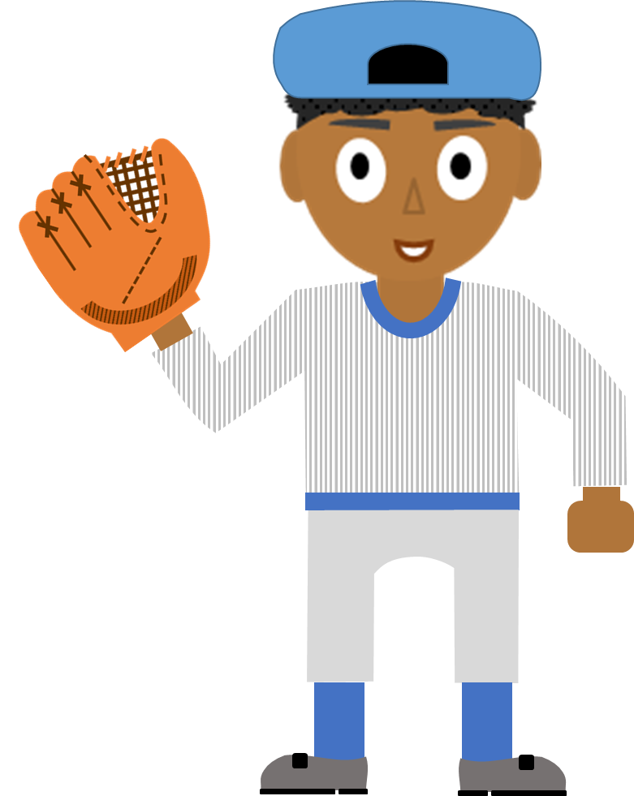
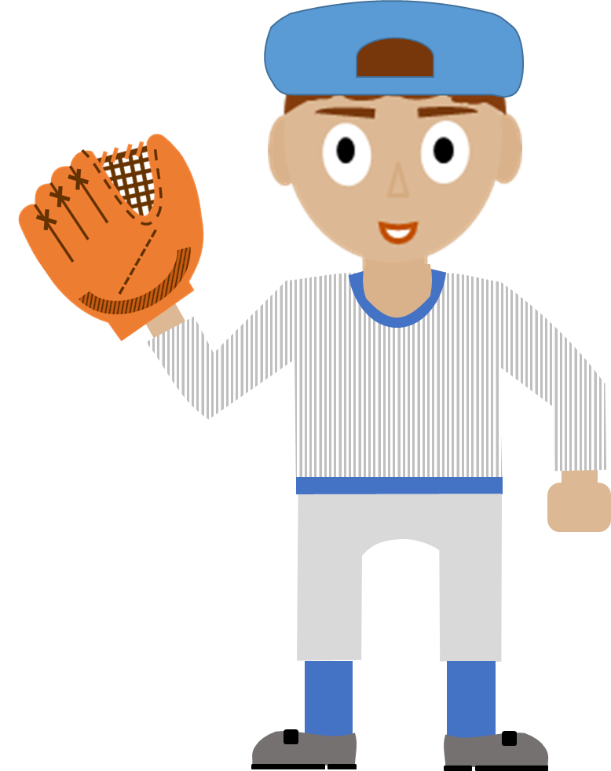
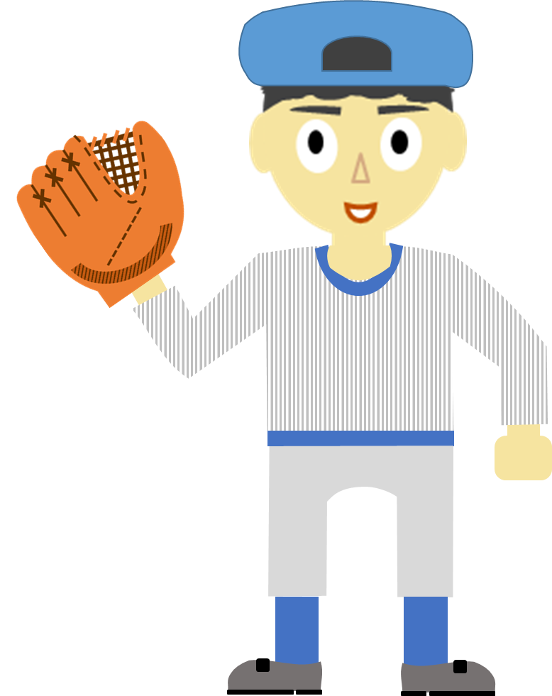
We Are Not All The Same
A baseball team does not need 4 shortstops.
Shortstop 1
Shortstop 2
Shortstop 3
Shortstop 4
Notes:
TELL: Hopefully the 4 key areas we have gone over has got you thinking about your staff and realizing that they are not all the same. Similar to a baseball team, they do not need everyone to be in the same position. A baseball team does not need 4 shortstops.

Slide 24
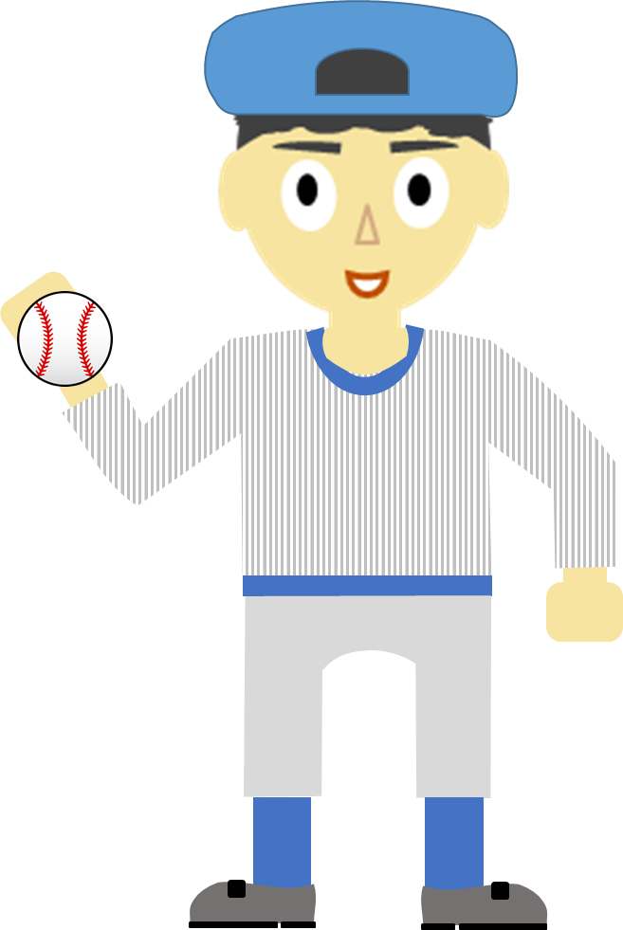
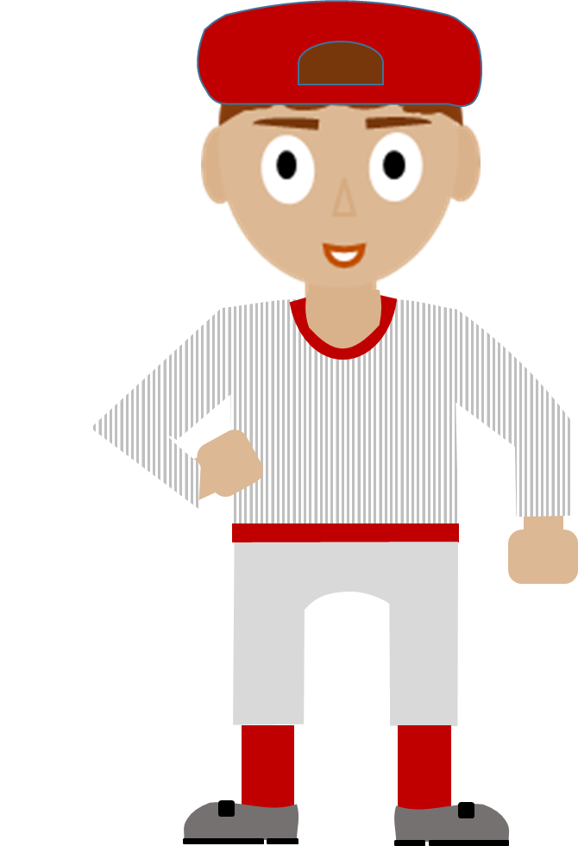
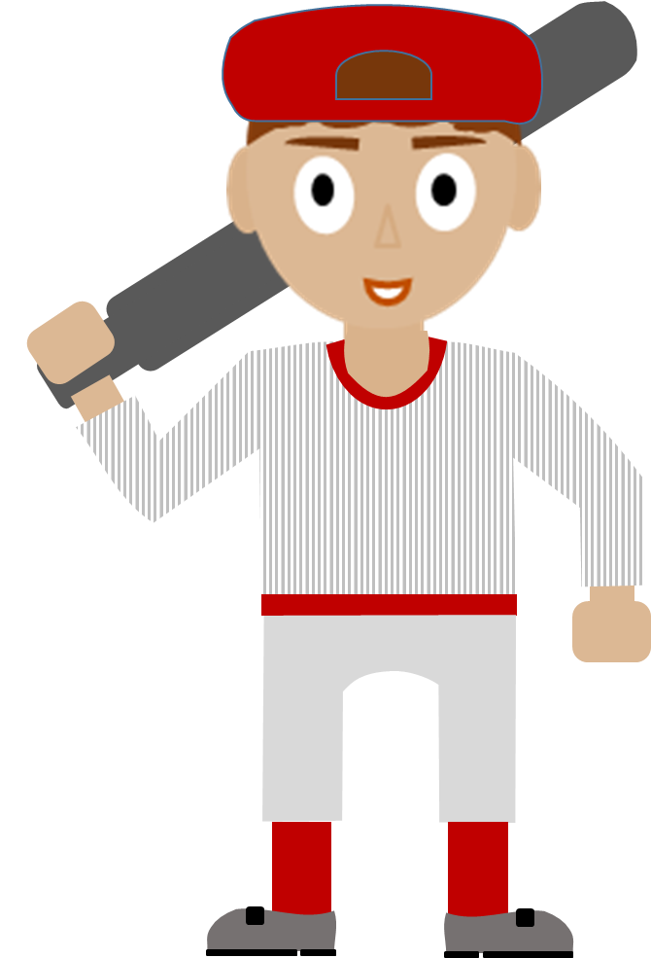
Everyone has a Role
A baseball team consists of a group of players with different roles that interdependently rely on each other.
Shortstop
Right Fielder
Catcher
Pitcher
OUT!
Notes:
TELL: Everyone on your team has a role. Similar to a baseball team consists of a group of players with different roles that interdependently rely on each other.

Slide 25
Teamwork in the Cafeteria
Just like a baseball team, your staff possesses different skillsets that come together to operate a successful Café LA.
Notes:
TELL: Just like a baseball team, your staff possesses different skillsets that come together to operate a successful Café LA.

Slide 26
Keeping on Target
What is a goal?
A goal is a desired result or possible outcome that someone envisions, plans and commits to achieve.
Why should we write our goals?
Those who wrote down their goals are 42% more likely to achieve them than those who did not.*
42%
Not all goals are created equal.
How do we set effective goals?
*Dr. Gail Matthews, Dominican University, California
Notes:
TELL: The last thing we’re going to talk about are goals. What is a goal? A goal is a desired result or possible outcome that someone envisions, plans and commits to achieve. Why should we write our goals? Those who wrote down their goals are 42% more likely to achieve them than those who did not.* How do we set effective goals?

Slide 27
Writing SMART Goals
Notes:
TELL: Setting SMART goals. S is for Specific. When creating your goals, ask yourself Who? What? Where? When? Why? For example: Goal, you want to run a smooth Café LA operation. That is not specific at all. How will you do that?
M is for Measureable. How will you know you’ve met your goal? How much? How many? For example: You want to increase lunch participation. Versus you want to increase lunch participation by 10%.
A is for Attainable. Is it in your power to achieve the goal? Do you have the resources and tools to achieve the goal? Is it realistic? You don’t want to set a goal that is impossible to reach.
R is for Relevant. Is the goal in line with the Café LA success? Does this goal fit in with your key objectives?
T is for Timely. Set a timeframe. When do you want to achieve the result?
For example: By the end of the month, we will reduce waste by 5%.
To set effective goals don’t forget to ask yourself these simple questions.

Slide 28
SMART Goals Example
Specific: Reduce food waste to 5% in the BIC program to cut costs and conserve resources.
Start with an idea: Reduce food waste in the BIC program
STEP 1
STEP 2
Measurable: Leftovers and waste data will be recorded in the BIC Tracking Log.
STEP 3
Attainable: Consider previous participation counts and particular items that students like to prepare each BIC bag with more accurate meal amounts.
STEP 4
Relevant: Keeping in-line with Food Services Division’s goal on track to reduce food waste in all food programs.
STEP 5
Timely: This goal should be achieved within the next 3 weeks.
STEP 6
Notes:
TELL: Taking the goal from the previous slide: Reduce food waste in the BIC program. Let’s revise it to make a SMART goal: Reduce food waste to 5% in the BIC program to cut costs and conserve resources. Consider previous participation counts and particular items that students like to prepare each BIC bag with more accurate meal amounts. Leftovers and waste data will be tracked in the BIC Tracking Log. This should be achieved within the next 3 weeks, keeping Food Services Division’s goal on track to reduce food waste in all food programs. Let break this SMART goal down to identify its components.

Slide 29
Create Your Own SMART Goal
Think of a goal you would like to reach in the next school year. Write the goal using the SMART Goal Guide.
Initial Goal: Write the goal you have in mind.
_________________________________________________________
S
Specific – Ask yourself, who, what, where, when, and why?
____________________________________________________
M
Measurable – How will you measure progress?
____________________________________________________
A
Attainable – Is it in your power to achieve the goal?
____________________________________________________
R
Relevant – Is the goal aligned with overall objectives?
____________________________________________________
T
Timely - When do you want to achieve the result?
____________________________________________________
Notes:
ACTIVITY: If time permits, allow the class 5 minutes to complete the activity. If there is not time, instruct the class to do it later or during the class transition.

Slide 30
+
Bridging the Gap
Café LA Staff
School Administrator
Students
Parents
Campus Aides
Teachers
Cafe LA Manager
Often times, there is a disconnect between school personnel, parents, and students.
Utilize these leadership tools to become the bridge that brings people together to achieve a student centered-focus.
Notes:
CLOSING: In closing, often times, there is a disconnect between school personnel, parents, and students. Utilize these leadership tools to become the bridge that brings people together to achieve a student centered-focus.

